Slide 1


Successfully Submitting a Small Business Grant Application Using ASSIST
October 2018

Slide 2

Today’s Topics
What is ASSIST?
Submission Options
Registration
Using ASSIST to Navigate the Submission Process
Finding Help & Resources
Questions

Slide 3

What is ASSIST?
ASSIST is NIH's online system for the
preparation, submission & tracking
of grant applications through Grants.gov to NIH

Slide 4
Application Forms
There is NOT a universal set of application forms that can be downloaded from our form library or websites
You must use the application form package attached to your funding opportunity announcement
  Each application form package includes the customized subset of forms supported by NIH which are needed for that opportunity
Application forms are accessed using your chosen submission option (e.g., ASSIST)

Slide 5

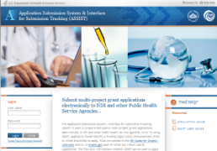


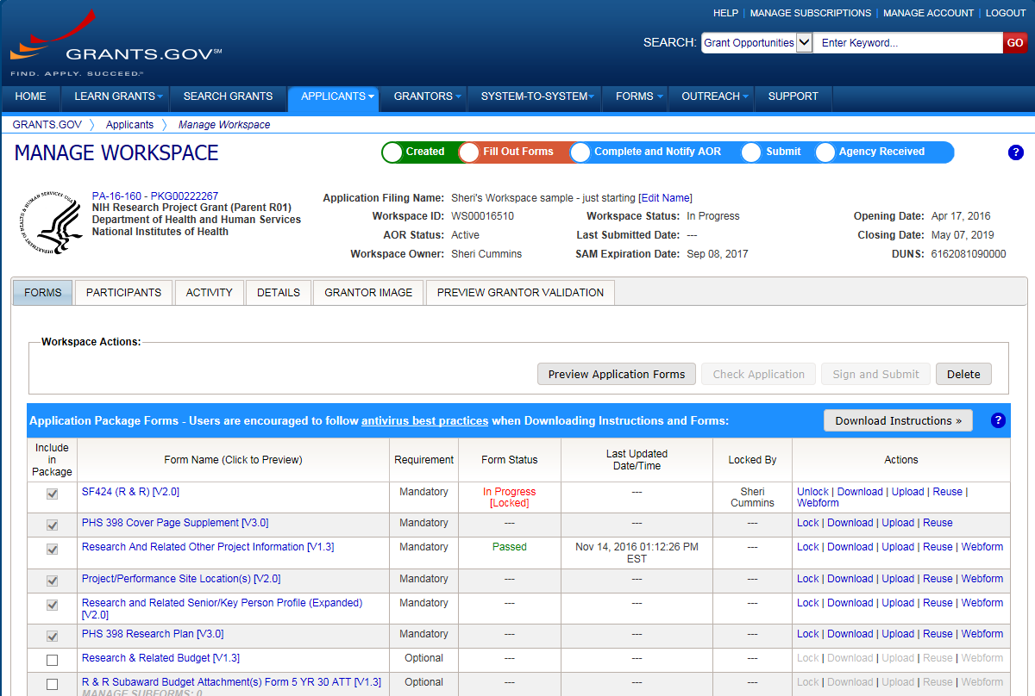




Application Submission Options
We recommend you USE ASSIST!
ASSIST
System-to-System
Workspace
https://grants.nih.gov/grants/how-to-apply-application-guide/prepare-to-apply-and-register/choose-a-submission-option.htm

Slide 6
Submission Options Used by NIH Small Business Applicants

Slide 7

Multiple Organization Registrations Required to Submit
Can take 6-8 weeks to complete all registrations.
If not yet registered – start now!
https://grants.nih.gov/grants/how-to-apply-application-guide/prepare-to-apply-and-register/registration.htm

Slide 8


Organization Registration
DUNS – provides unique organization identifier
SAM (System for Award Management) – needed to do business with government
  Requires annual renewal
Grants.gov – required to submit grants
eRA Commons – required to do business with NIH
SBA (Small Business Administration) – required for SBIR/STTR applications
https://grants.nih.gov/grants/how-to-apply-application-guide/prepare-to-apply-and-register/registration/org-representative-registration.htm

Slide 9
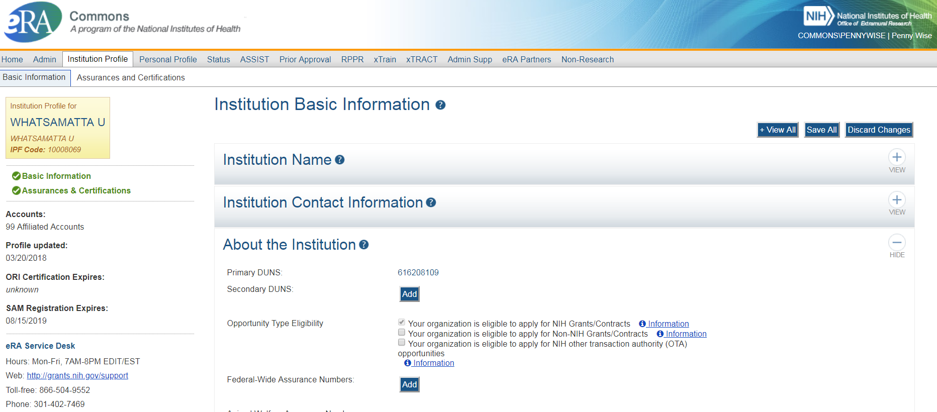
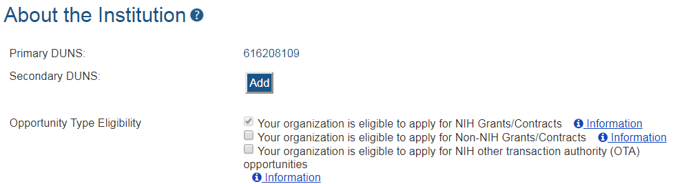
Verify Your eRA Commons Institution Information
Signing Official (SO) should verify registration is set-up to apply to NIH

Slide 10



Understand Key Systems & Roles
Grants.gov
eRA Commons
E-Business Point of Contact (EBiz POC)
Authorized Organization Representative (AOR)
Signing Official (SO)
Principal Investigator (PI)
Anyone doing data entry in ASSIST needs an account
https://grants.nih.gov/grants/how-to-apply-application-guide/prepare-to-apply-and-register/registration/investigators-and-other-users.htm

Slide 11

eRA Commons Account Reminders
Do not combine administrative (e.g., SO) and scientific (e.g., PI) roles on single Commons account
  If the same person serves both functions, two accounts are needed
PIs get one Commons account that follows them throughout their careers
If PI is already registered, “affiliate” their existing account rather than creating a new one
  PIs should update their Commons profile prior to submitting

Slide 12








Now Let’s Talk About the Application Process
Step 1: Find
Step 2: Plan
Step 3: Initiate
Step 4: Build team
Step 5: Enter data
Step 6: Finalize
Step 7: Submit
Step 8: Track

Slide 13

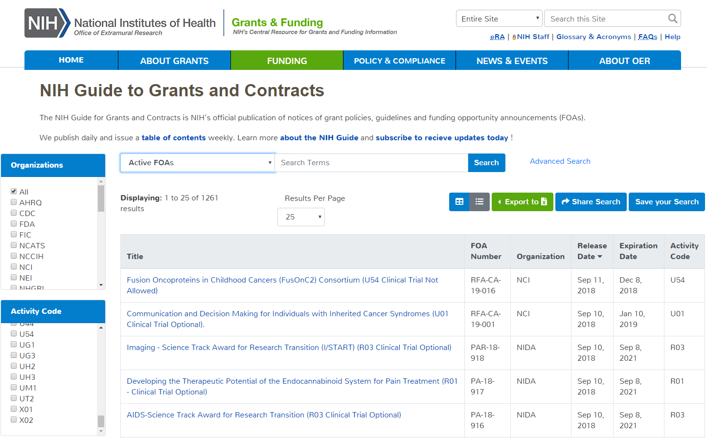
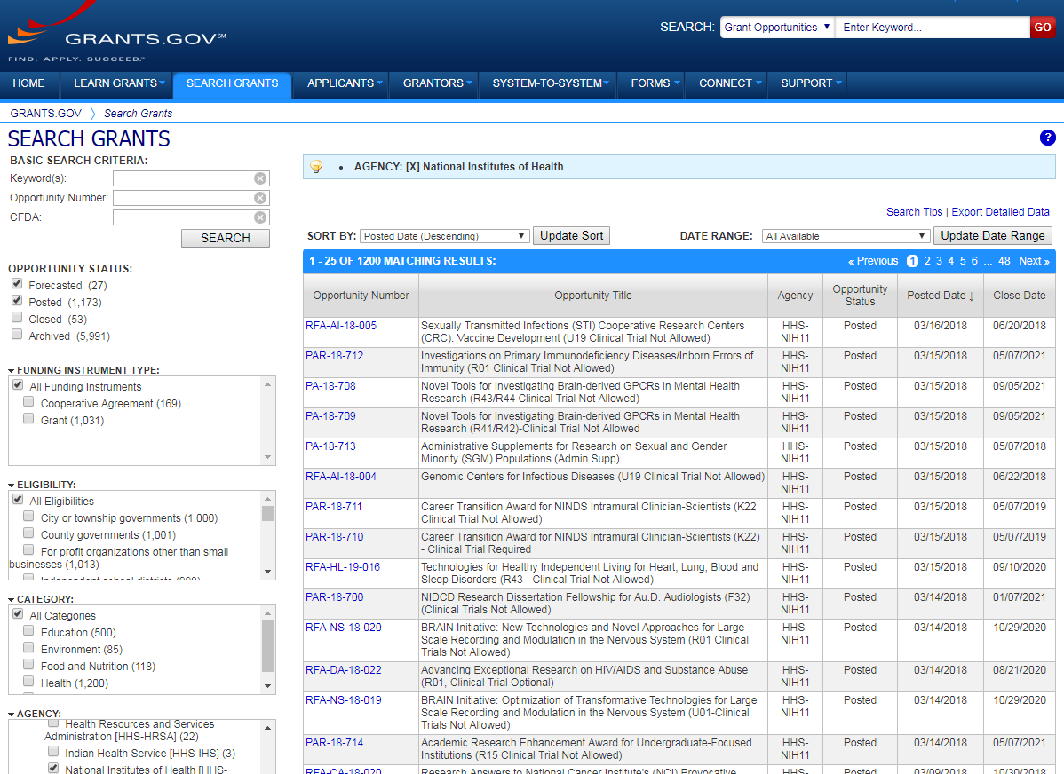
Step 1: Find an Opportunity of Interest
NIH Guide for Grants & Contracts
Grants.gov Search Grants
Each system has robust search capabilities.

Slide 14
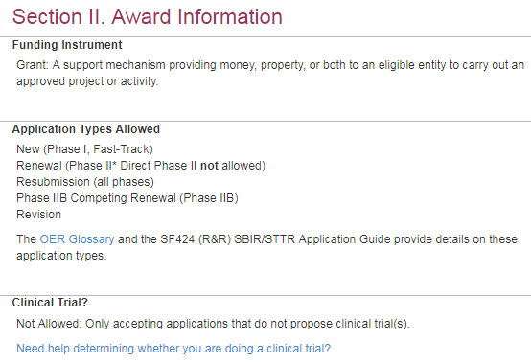
Clinical Trial Specific FOAs
NIH requires that all applications involving one or more clinical trials be submitted through a Funding Opportunity Announcement (FOA) specifically designed for clinical trials.
FOAs include clinical trial allowability
indicator
  Section II of all FOAs
  Title of most FOAs
    If title does not include clinical trial allowability
    indicator, then independent clinical trials are
    NOT allowed
https://grants.nih.gov/policy/clinical-trials/specific-funding-opportunities.htm

Slide 15
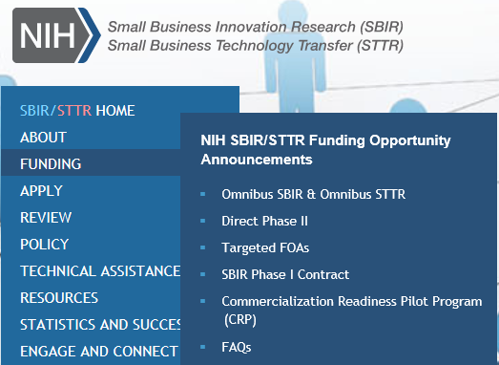
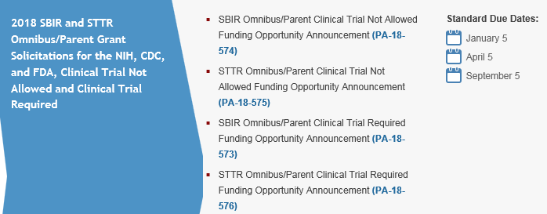
SBIR/STTR
Funding Opportunity Announcements
The SBIR/STTR website provides direct links to omnibus and other funding opportunity announcements.
SBIR Clinical Trial Not Allowed
STTR Clinical Trial Not Allowed
SBIR Clinical Trial Required
STTR Clinical Trial Required
http://sbir.nih.gov/

Slide 16
SBIR/STTR
Standard Due Dates
Standard Due Dates
http://sbir.nih.gov/

Slide 17
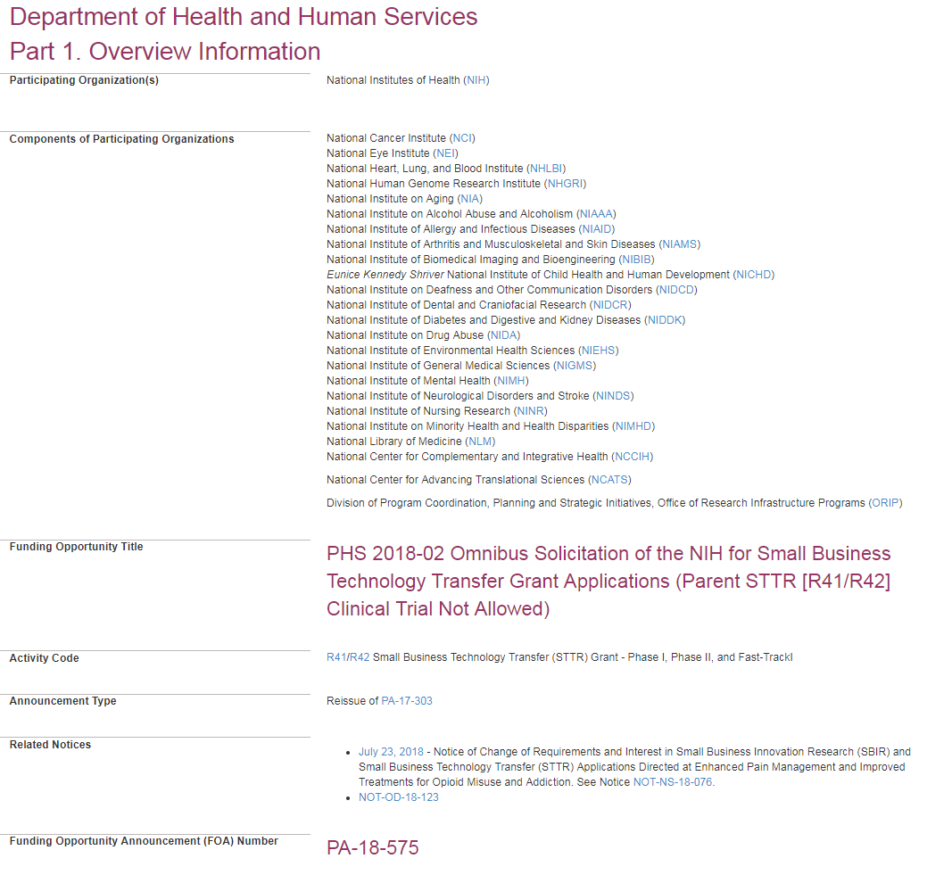
FOA
Carefully read full opportunity announcement
Your application must fit within the mission of one of the participating institutes
Check for updates in Related Notices

Slide 18
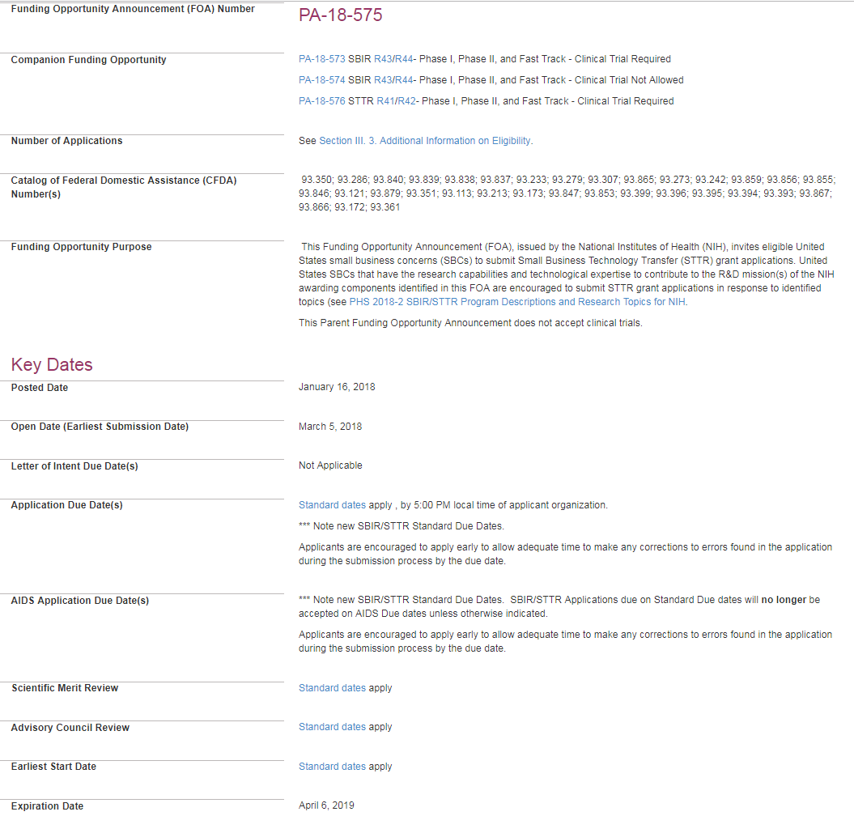
FOA 2
Due Dates section links to standard dates web page or lists specific due dates

Slide 19
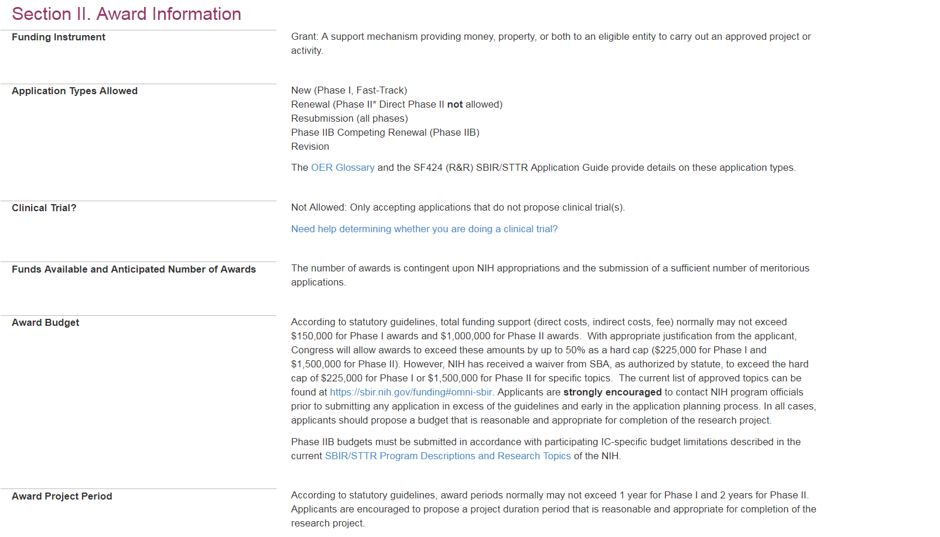
Section II. Award Information
Application Types
Clinical Trial Indicator
Budget limits
Period limits

Slide 20
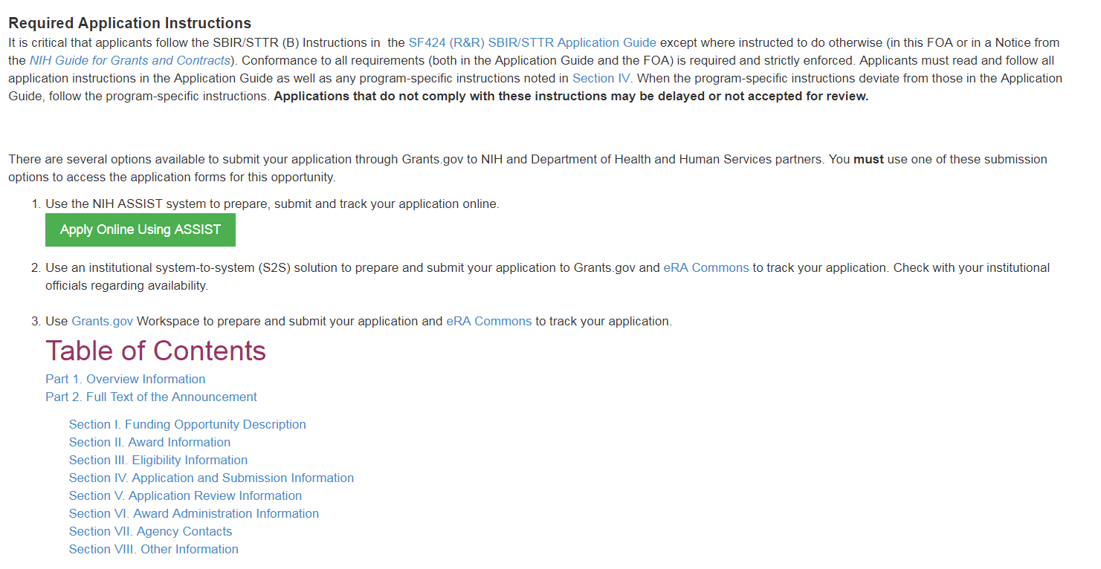
FOA & Application Guide Instructions
Link to Application Guide
Link to ASSIST
Pay special attention to Section IV. Application and Submission Information
Includes any FOA-specific submission instructions

Slide 21
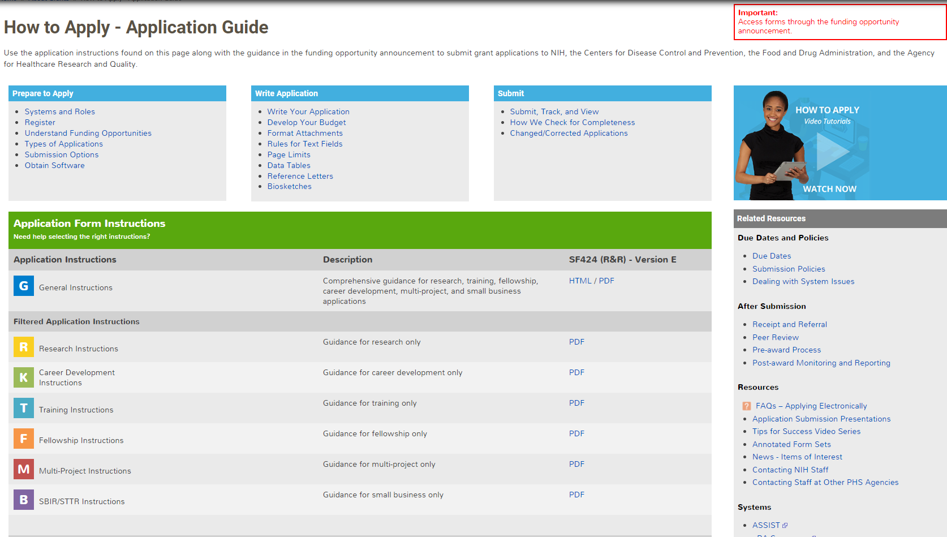
How to Apply – Application Guide
General Application Process Information
Form Instructions
Resources

Slide 22
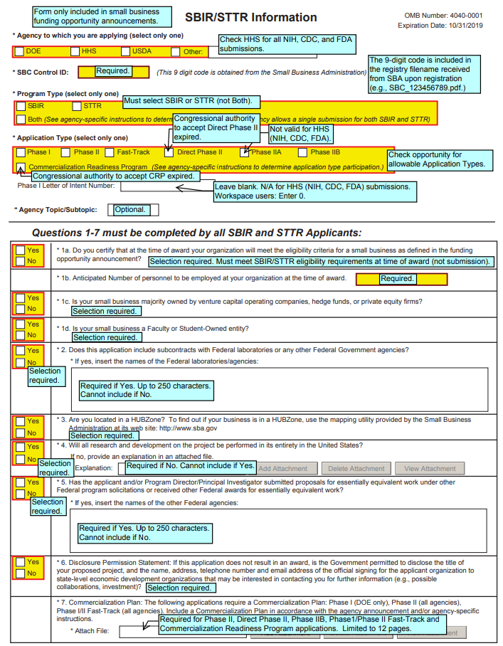
Follow All Guidance
Follow All Guidance
Handy Resource
Annotated form sets
Notices in NIH Guide for Grants & Contracts
Funding Opportunity Announcement
  Section IV. Application and Submission Information
How to Apply - Application Guide
Precedence / Importance

Slide 23

Step 2: Plan for Your Submission
Identify team members
  Gather Commons Usernames for anyone who will be working in ASSIST
Verify registrations are in place and active
Choose submission method
Determine application preparation responsibilities
  Who will – prepare budget, gather data, create attachments, do data entry
Make sure everyone is aware of process
  Internal review & approval process
  Post-submission responsibilities
    How to deal with errors/warnings
    Who will verify application in eRA Commons?

Slide 24

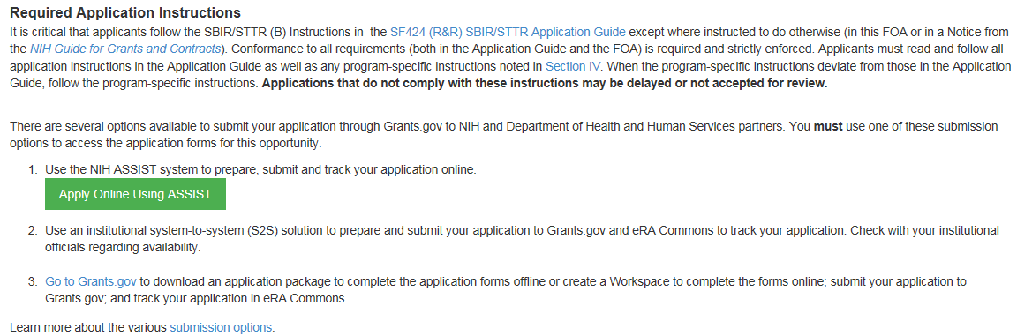

Step 3: Login to ASSIST & Initiate Application
Excerpt from FOA in NIH Guide…
https://public.era.nih.gov/assist
Login with eRA Commons Username & Password

Slide 25
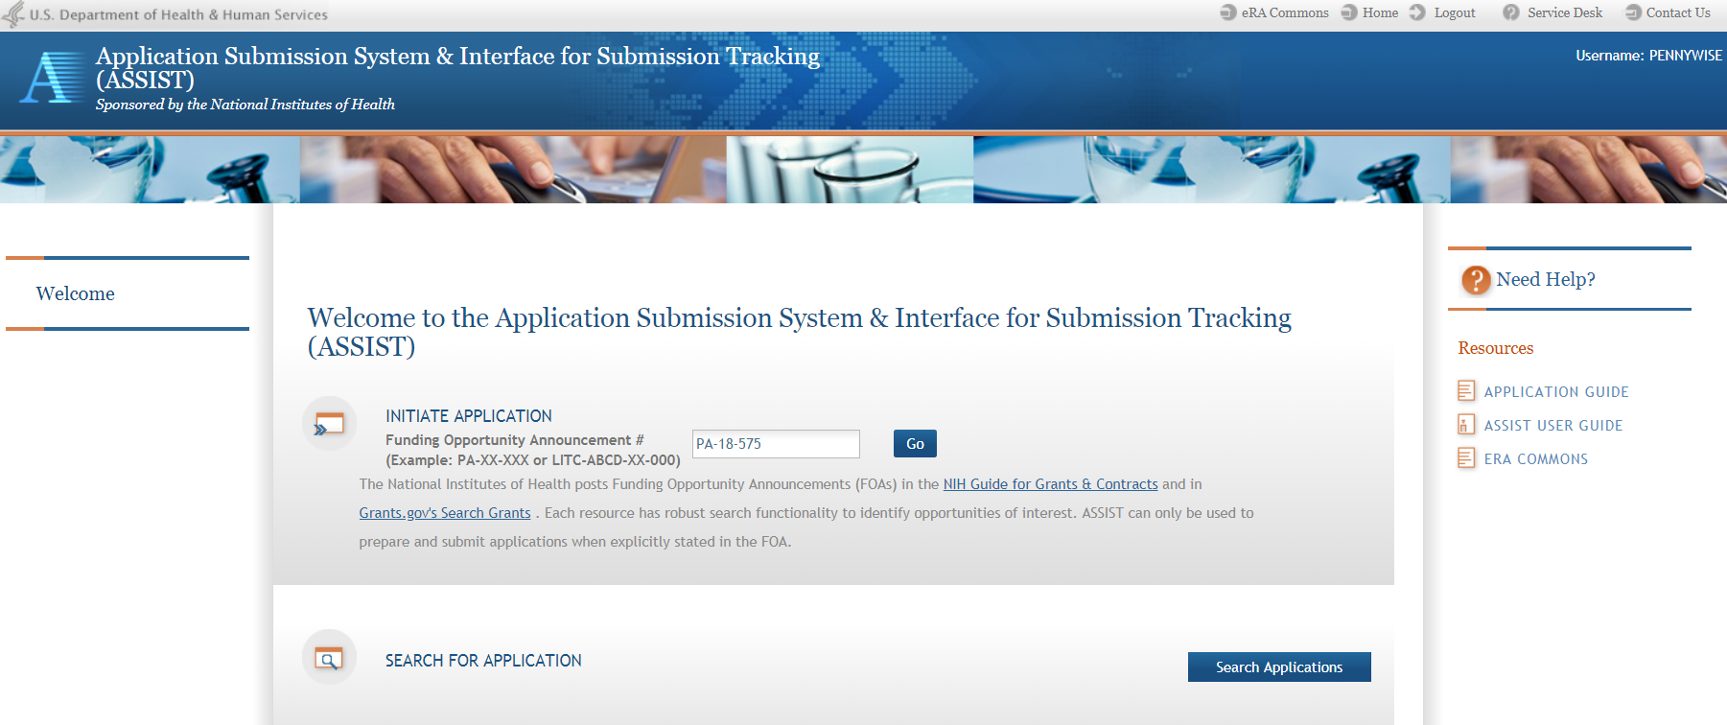
ASSIST Welcome Screen
Initiate Application
Search for Application

Slide 26
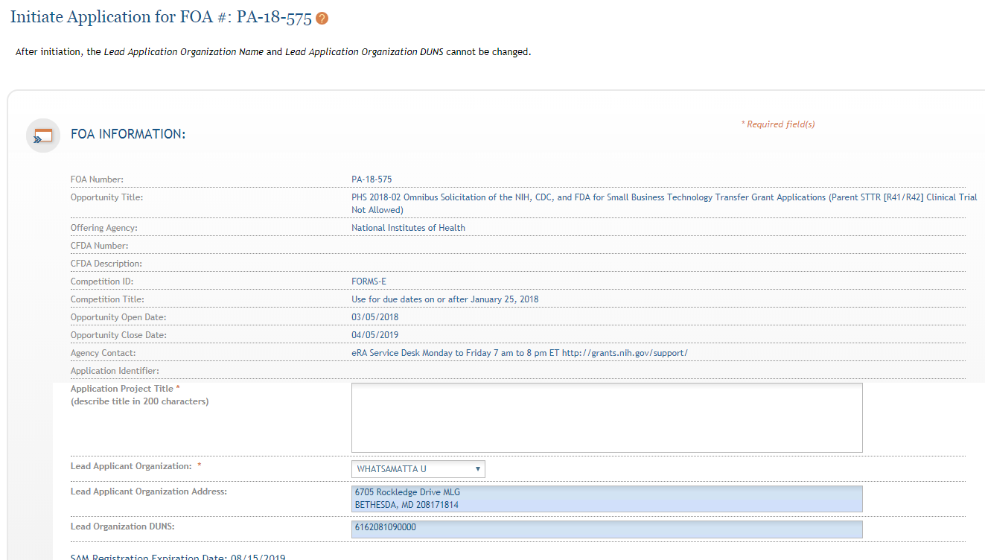
ASSIST Initiate Screen
FOA information pulled from Grants.gov
Enter Project Title
Drop-down list of organizations affiliated with your eRA Commons account
Data pre-populated from organization selection
26

Slide 27
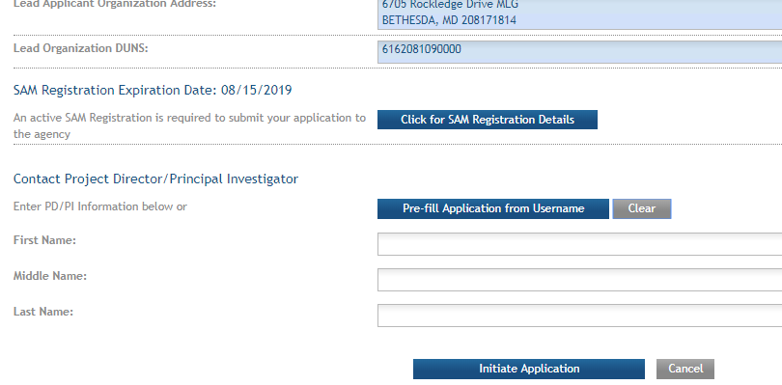
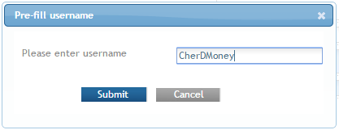
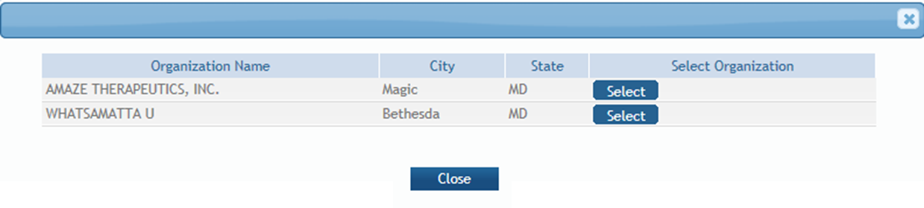
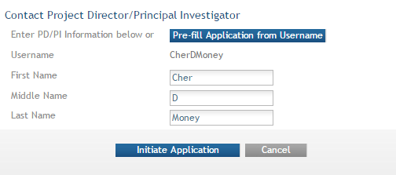
Initiate –
Pre-population
Visibility to SAM registration expiration date & details
Can manually enter PD/PI information or provide eRA Commons username to auto-populate
If multiple employment records, select appropriate record for application.

Slide 28
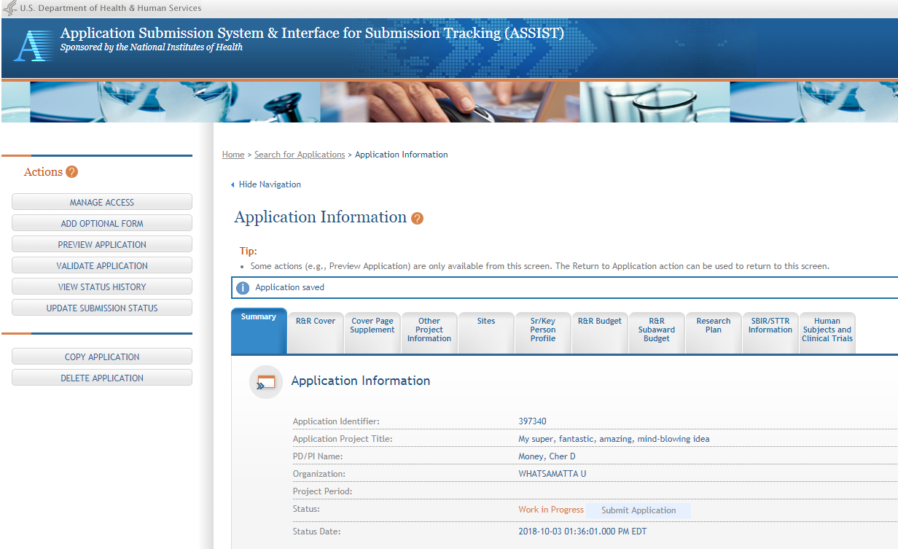
Screen Layout
Access online help
Screen tips
ASSIST messages
Form navigation
Actions - vary based on application context and access

Slide 29


Step 4: Build Your Team
Provide application access to appropriate team members
ASSIST automatically provides application access to some individuals based on their Commons roles or role on the application
  Users with eRA Commons accounts that have the Signing Official (SO) or Administrative Official (AO) role have access to all applications for their organization
  PD/PIs have access to all applications for which they have been given the PD/PI role
  Application initiator has automatic access
Addition team members can be added to a specific application using the Manage Access feature

Slide 30

Manage Access
Provides ability to give anyone with a valid eRA Commons account access to an application
Automatically available to users with
  Signing Official (SO) role on eRA Commons account
  ASSIST_ACCESS_MAINTAINER_ROLE role on eRA Commons account
Available on application-by-application basis to
  ASSIST user who has been given the Access Maintainer
  role by an SO via the Manage Access action

Slide 31
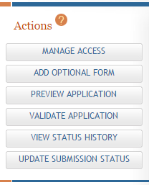
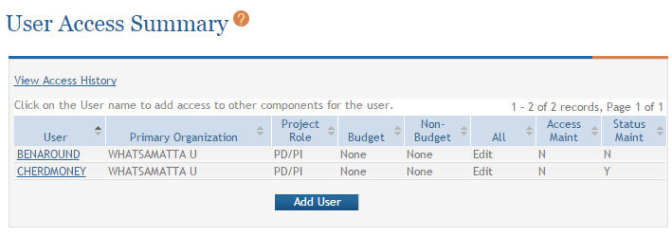
Manage Access Screens
Change current access
Provide access to additional users

Slide 32
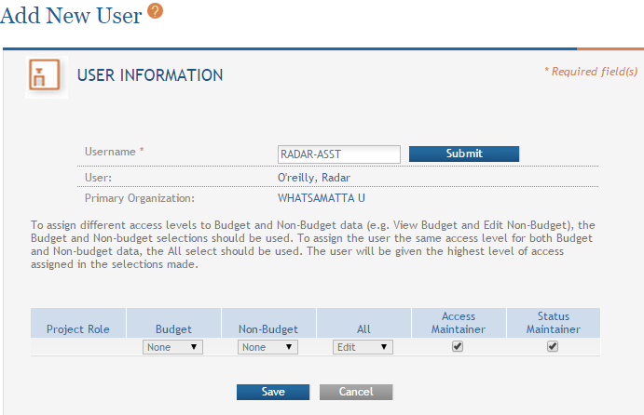
Add New User
Provide Commons Username
Delegate ability to control access to the application
Control access level
Delegate ability to change application status

Slide 33

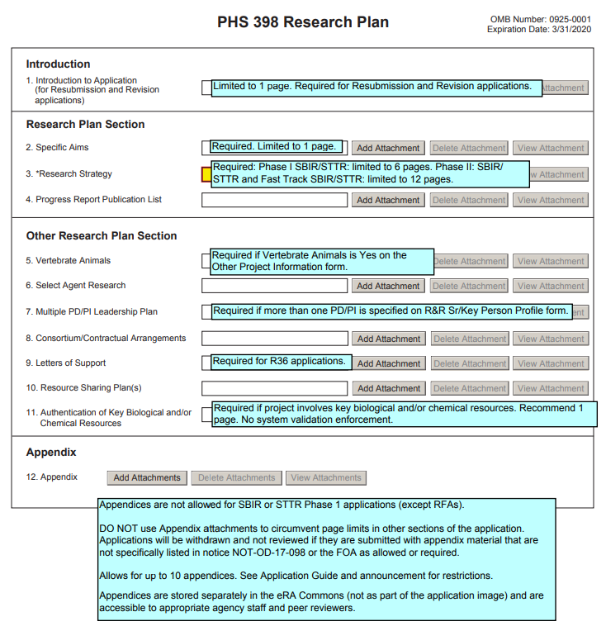
Step 5: Enter Data
Follow All Guidance
Handy Resource
Notices in NIH Guide for Grants & Contracts
Funding Opportunity Announcement
  Section IV. Application and Submission Information
How to Apply - Application Guide
Annotated form sets
Precedence / Importance
https://grants.nih.gov/grants/how-to-apply-application-guide.html

Slide 34
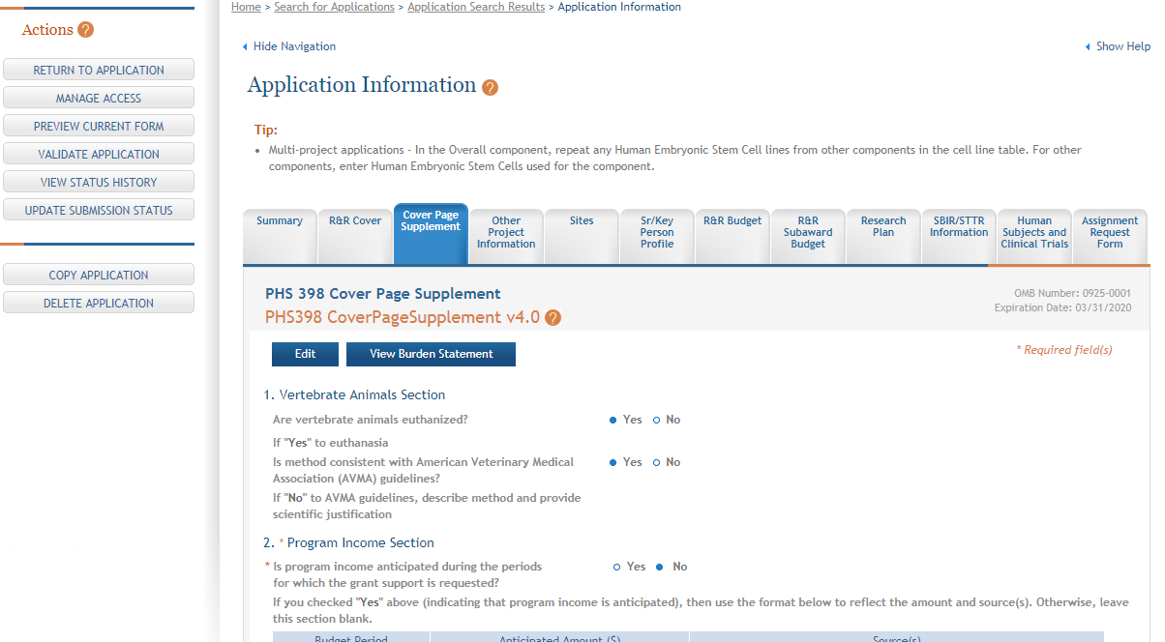
Data Entry Screens - Edit
Click each tab to access form data entry screens
Clicking Edit blocks other users from editing form

Slide 35
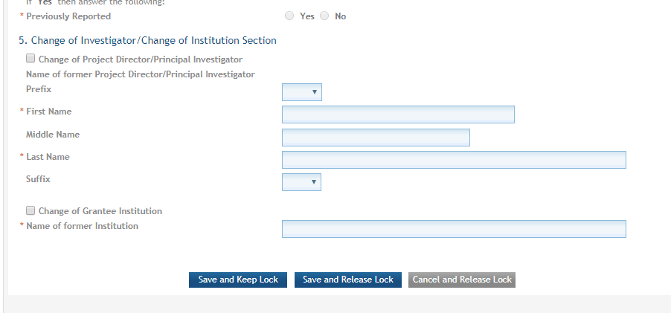
Data Entry Screens - Save
Save and continue to lock out others from editing this form
Save and release lock on form so others can edit this form

Slide 36
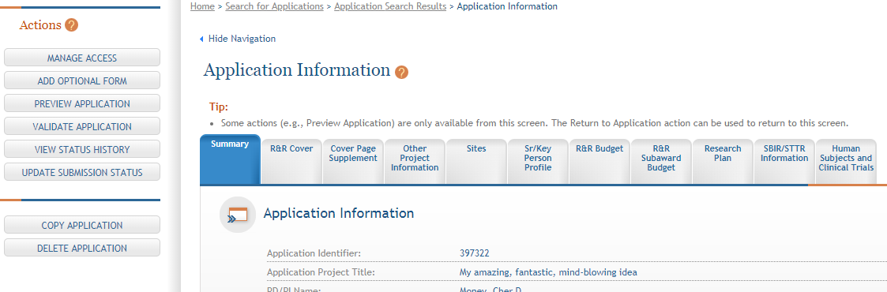
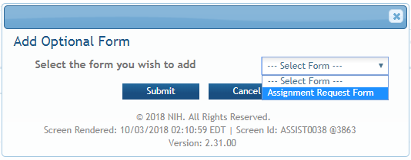
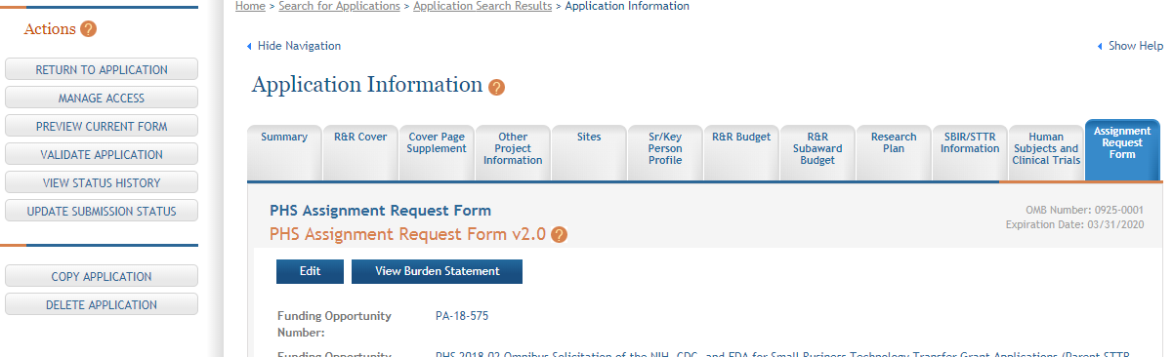
Add
Optional Form
Select form and click Submit
The form tab is added to navigation

Slide 37

Avoid Common Errors: Include All Required Attachments
Whether an attachment is required or not is often based on how you answer specific questions throughout the application
  Examples:
    Vertebrate Animals = Yes, then Vertebrate Animals attachment is required
    More than one entry on the R&R Sr/Key Person Profile form with the role of “PD/PI,” then the Multiple PD/PI Leadership Plan attachment on the PHS 398 Research Plan form is required

Slide 38
Avoid Common Errors: Special Small Business Attachments
SBIR applications
In the Other Attachments section of the R&R Other Project Information form:
  Attach proof of your SBA registration
  Attach the “SBIR Application VCOC Certification.pdf” if your organization is venture capital backed
    Find it here: http://grants.nih.gov/grants/forms.htm#sbir

Slide 39
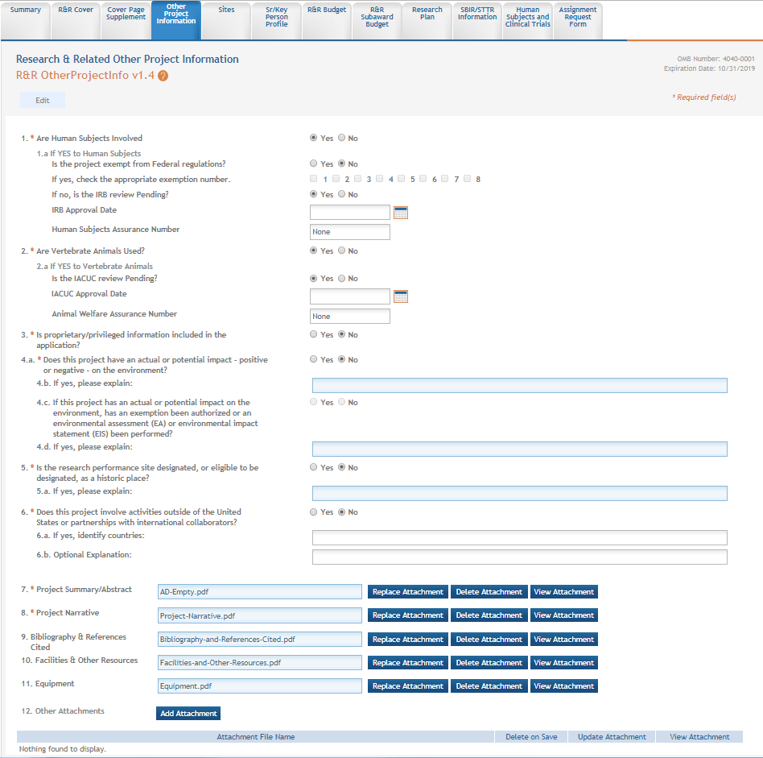
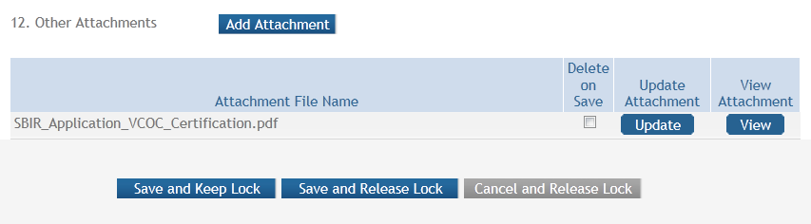
Other Attachments Section
Other Project Information form
Other Attachments section

Slide 40

Avoid Common Errors: Use PDF Format for All Attachments
Use simple PDF-formatted files
  Do not electronically sign your individual attachments
  Disable security features such as password protection
Keep file names to 50 characters or less
Use meaningful filenames
Do not include headers or footers
  Section headings as part of the text (e.g., Significance,
  Innovation, Approach) are encouraged
Follow guidelines for fonts and margins
Format Attachments:
https://grants.nih.gov/grants/how-to-apply-application-guide/format-and-write/format-attachments.htm

Slide 41
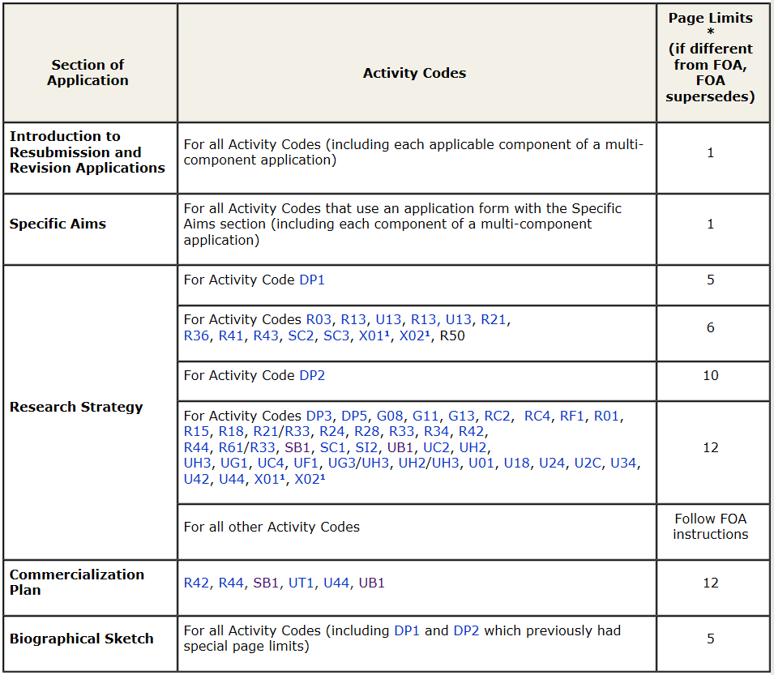

Avoid Common Errors: Follow Specified Page Limits
Page Limits: https://www.grants.nih.gov/grants/forms_page_limits.htm#other

Slide 42

Step 6: Finalize Your Application
Validate your application data against system-enforced NIH business rules
Generate a pre-submission image of your assembled application in the NIH format
Update Submission Status to “Ready for Submission”

Slide 43
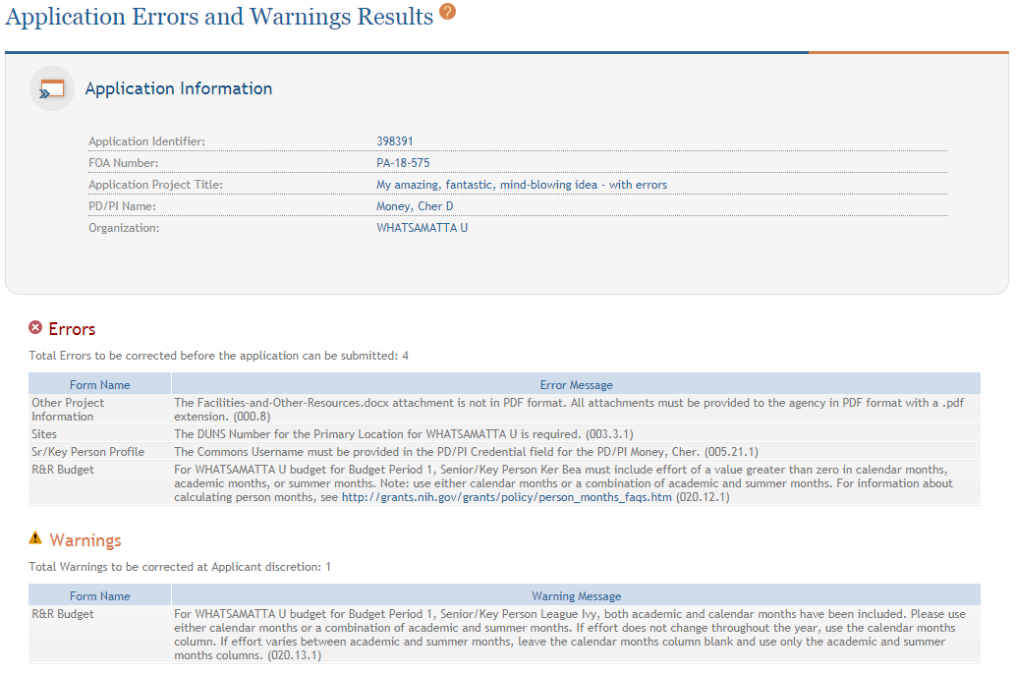
Validate Application
Errors and Warnings are displayed

Slide 44


Corrective submissions must be made BEFORE the submission deadline and overwrite previous submissions.
Errors stop application processing and must be corrected
  You will be unable to submit in ASSIST until all identified errors are corrected
Warnings do not stop application processing and are corrected at the discretion of the applicant

Slide 45
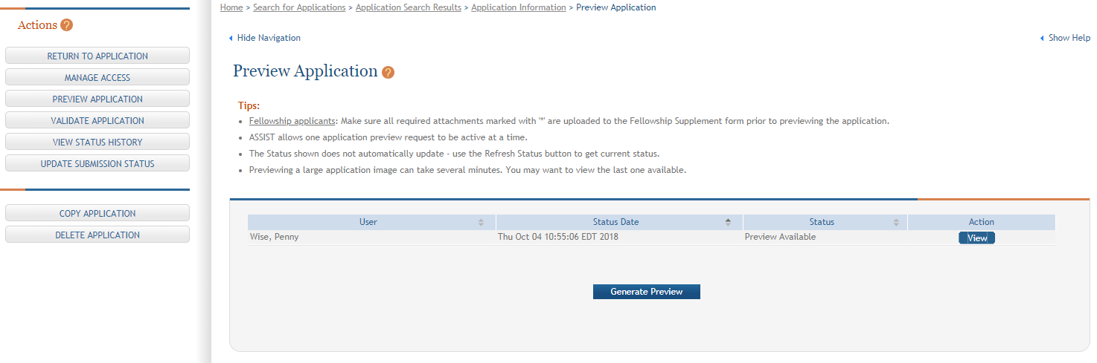
Generate Application Preview in Agency Format
View last preview
Generate new preview

Slide 46
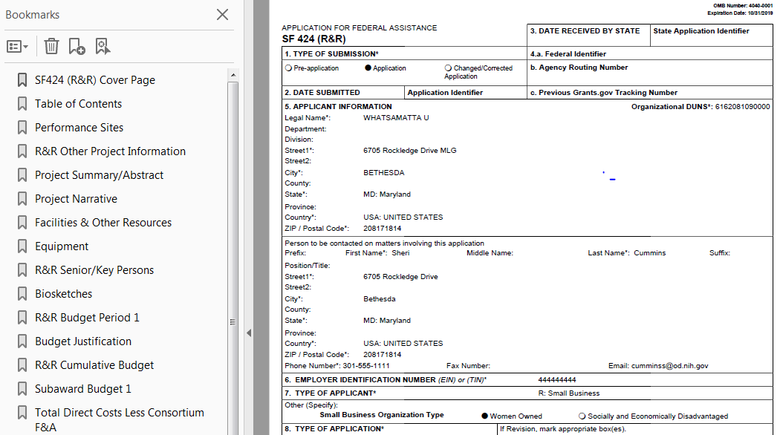
Application Preview
The preview is exactly how your application would be assembled upon submission, except a few items in the footer (e.g., Grants.gov tracking number, submission timestamp) are not filled in.

Slide 47
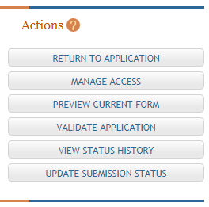
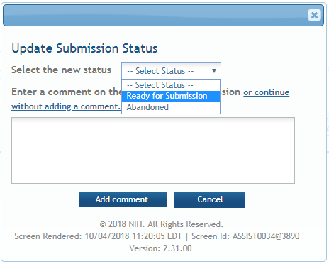
Update Submission Status
Select status
Enter comment to be added to status history

Slide 48
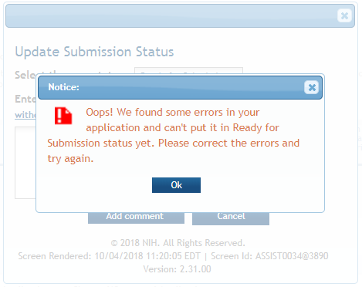

Final Check for Errors
Before an application is changed to Ready for Submission status, it must pass validations (Warnings are OK).

Slide 49
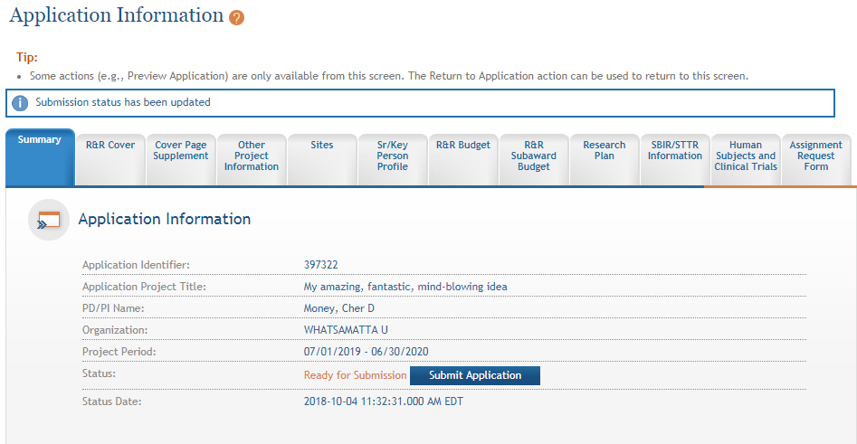
Updated Status Reflected in Summary Tab

Slide 50


Step 7: Submit Your Application
Only folks with an eRA Commons SO (Signing Official) account and a Grants.gov AOR (Authorized Organization Representative) credentials can submit
Deadline = 5 p.m. local time of submitting organization on due date
  All registrations and SAM renewal must be completed before the deadline
  Application must be free of all federal system-identified errors (Grants.gov & eRA)
  NIH’s late policy does not allow corrections after the deadline
  NIH recommends submitting early to allow time to correct
  any unexpected errors or submission issues

Slide 51

Pop Quiz
The appropriate measurement for “early” in the context of application submission is…
Minutes
Hours
Days
Measure early on a calendar not a clock.

Slide 52
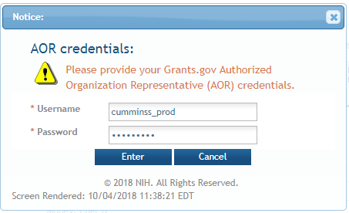
Submit Application
For Submit button to be active, user must be logged into ASSIST with an SO account and the application must be in a Ready for Submission status.

Slide 53
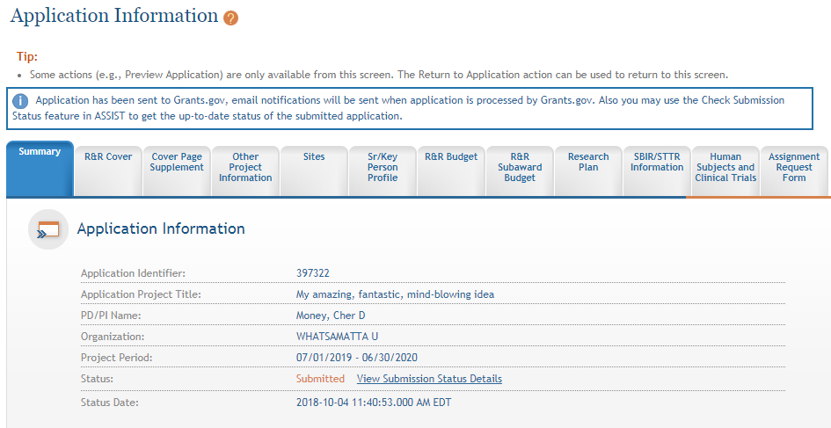
Application Sent to Grants.gov
Message indicates application has been sent to Grants.gov.

Slide 54

You’re Not Finished Yet…
Application
Successfully
submitted
to NIH
Submitting to Grants.gov is NOT the last step in the process!

Slide 55

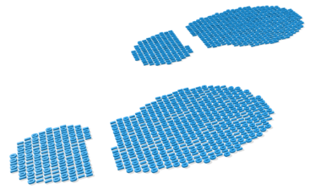
Step 8: Track Your Application
eRA Commons Status is an integral part of your submission
  Applications that pass Grants.gov validations are picked up by eRA Commons and checked against many application guide and opportunity instructions
Authorized users can check eRA Commons Status for processing results
  Signing Officials (SOs)
  Administrative Officials (AOs)
  Principal Investigators (PIs)
  Delegated Assistants (ASSTs)
E-mail notifications sent

Slide 56
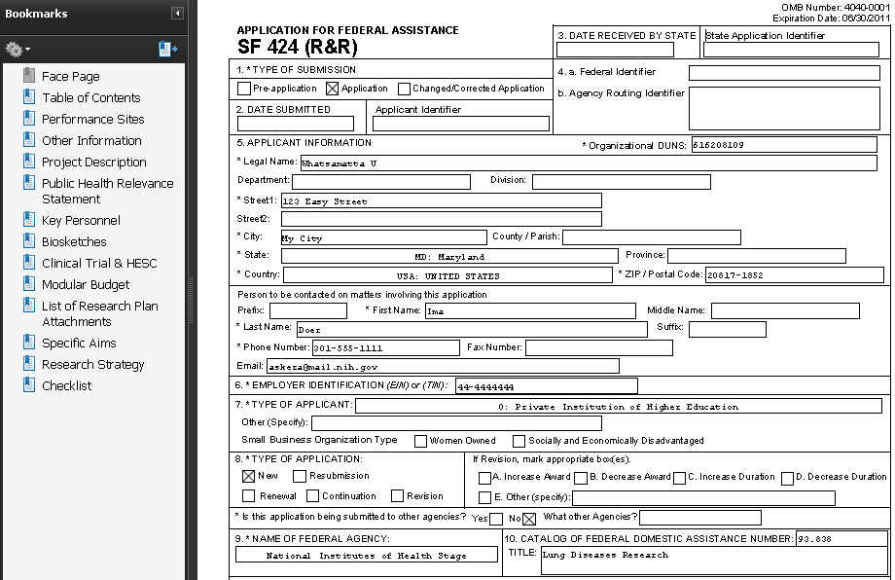

Application Image Assembly
Once an error-free application is received by NIH, the eRA system will:
  Assemble the grant application image
  Insert headers (PI name) and footers (page numbers) on all pages
  Generate Table of Contents and bookmark important sections
  Post the assembled application image in the PD/PI’s eRA Commons account
  Send notification
    Email can be unreliable – proactively
    check application status

Slide 57

Application Viewing Window
Applicants have two (2) business days to view the assembled application image before the application automatically moves forward for further processing
Signing official can Reject application in eRA Commons within viewing window to prevent it from moving forward to NIH
Changed/Corrected applications must be submitted before the submission deadline
If you can’t VIEW it, we can’t REVIEW it!

Slide 58
View Submission Status Details
Submit button replaced with link to track status.

Slide 59
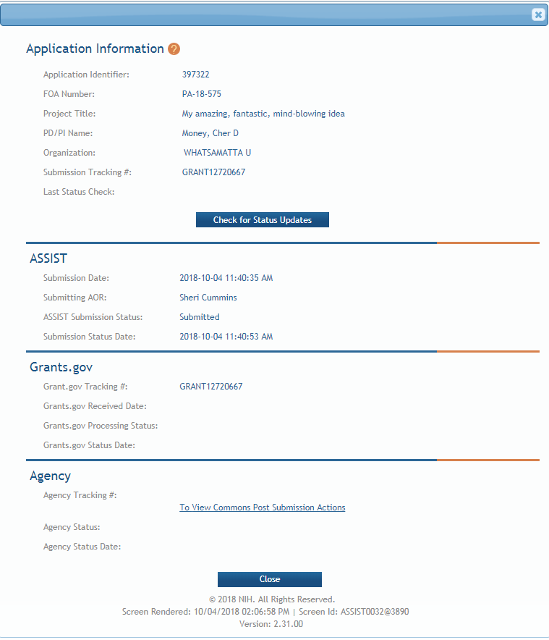
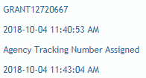
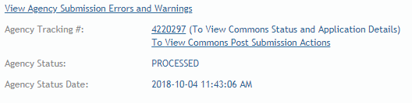
Follow status through all systems.
It can take anywhere from a few minutes to a few hours to process an application
You may have to click the Check for Status Updates button multiple times before status shows for all systems.

Slide 60
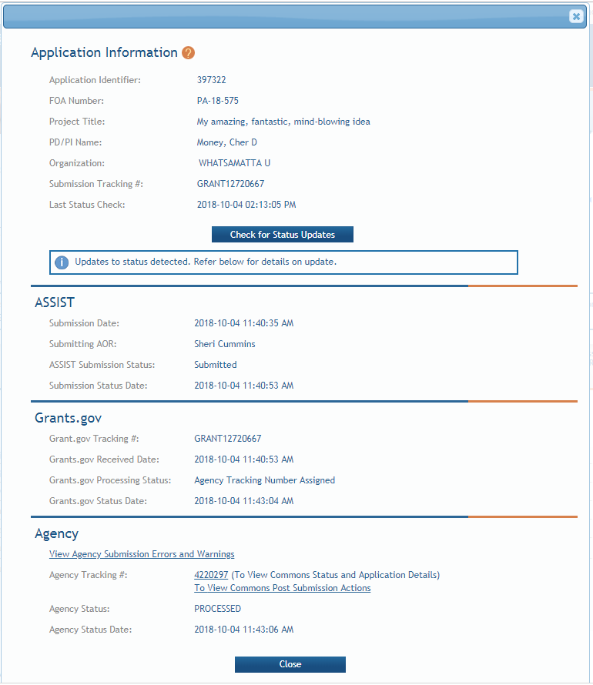
Assignment of Agency Tracking Number indicates application image is available.
Grants.gov tracking number and timestamp used to determine on-time submission.
Direct link to eRA Commons detailed status screen for the submission.

Slide 61

Viewing Your Application in eRA Commons
eApplication is the application image reviewers use.
Cover Letter, PHS Assignment Request Form, and Appendices (when allowed) are stored separate from the image.

Slide 62

View Application Image (e-Application)
The e-Application in eRA Commons is the same document seen by NIH staff and reviewers.
If you can’t VIEW it, we can’t REVIEW it!
Closely check the version in eRA Commons, even if you checked the preview.

Slide 63

Submission Complete!
If no action is taken during the two business day viewing window, the application automatically moves forward for further processing at NIH

Slide 64

Application Checks (Validations)
We really care about the details
Multiple levels of application checks for completeness
  Grants.gov
  eRA systems
  Agency staff
https://grants.nih.gov/grants/how-to-apply-application-guide/submission-process/check-your-application.htm

Slide 65

Sample Validations
Grants.gov
eRA Systems
Agency Staff
Active System for Award Management (SAM) registration
Submitter has AOR role for DUNS on application
Submission made to active opportunity and application package
Virus check
Filenames include only appropriate characters
Fields required by agency, but not required federal-wide
  R&R Sr/Key form
    Credential for PD/PIs
    Organization name for all sr/key
    Biosketch for all sr/key
  Performance Site form
    DUNS for primary site
Attachments in PDF format
Adherence to page limits in our Table of Page Limits
All appropriate attachments included
Fit with NIH/Institute mission
Eligibility
“Overstuffing”
On-time submission
Adherence to funding opportunity announcement specific instructions
Font and margin guidelines
Simultaneous review of essentially same application

Slide 66

Dealing with System Issues
You must follow NIH’s standard ‘system issue’ procedure if you run into federal system problems beyond your control that threaten your on-time submission:
https://grants.nih.gov/grants/how-to-apply-application-guide/due-dates-and-submission-policies/dealing-with-system-issues.htm

Slide 67

Resources

Slide 68

eRA Service Desk
Web: https://grants.nih.gov/support/
Phone: 1-866-504-9552
Hours : Mon-Fri, 7a.m. to 8 p.m. ET
Although we’ve worked closely with Grants.gov, ASSIST is a system developed and managed by NIH.
The eRA Service Desk should be your first stop for support.

Slide 69
Online Resources & Websites
NIH SBIR/STTR: https://sbir.nih.gov/
NIH Grants and Funding: https://grants.nih.gov/grants/oer.htm
How to Apply – Application Guide
https://grants.nih.gov/grants/how-to-apply-application-guide.html
Annotated form set
https://grants.nih.gov/grants/how-to-apply-application-guide/resources/annotated-form-sets.htm
Preparing Your Application Using ASSIST
https://grants.nih.gov/grants/how-to-apply-application-guide/prepare-to-apply-and-register/submission-options/assist.htm

Slide 70

Questions?

